Slide 1
Digital Portfolio
STUDENT NAME:B.KESAV
REGISTER NO 212402370
NMID: 1301212402370
DEPARTMENT: BCA
COLLEGE: COLLEGE/ UNIVERSITY:A.M.JAIN COLLEGE

Slide 2
STUDENT PORTFLIO

Slide 3


AGENDA
Problem Statement
Project Overview
End Users
Tools and Technologies
Portfolio design and Layout
Features and Functionality
Results and Screenshots
Conclusion
Github Link
3/21/2024 Annual Review

Slide 4

PROBLEM STATEMENT
In today's competitive digital landscape, individuals often struggle to effectively showcase their skills, work, and personal brand online. Without a personal portfolio, it's difficult to stand out to potential employers, collaborators, or clients. The lack of a centralized, visually appealing, and professional platform limits career opportunities and personal branding

Slide 5

PROJECT OVERVIEW
This project is a personal portfolio website developed using HTML, CSS, and JavaScript. The portfolio introduces me, displays my academicachievements,certificates,education background,and provides direct communication through a contact form. The design is made visually appealing with background GIF animations, smoothnavigation,and interactivecertificate pop ups.

Slide 6

WHO ARE THE END USERS?
Recruitersand hiring managerslooking
to assesstechnicaland creative skills
Clients or businesses interested in
digital
marketing, automation,or webdevelopment
services
Collaborators or peers in tech/startups
seeking partnerships
General audience interested in learning
more about my
workand skills.

Slide 7

TOOLS AND TECHNIQUES
HTML→forwebpagestructure CSS→forstyling layout and animations JavaScript→ for interactivity  certificate popup navigation BrowserCodeEditor→Chrome VSCode.

Slide 8
POTFOLIO DESIGN AND LAYOUT
The portfolio is divided into clear sectionswith a navigation bar  Home About Me→Profilepictureintroduction andshort bio Education→Myacademicbackgroundandcoursedetails Contact →Emailformforvisitors toreach me.
8

Slide 9
FEATURES AND FUNCTIONALITY
●ResponsiveDesign–Worksseamlesslyacrossdesktops tablets and smartphones
● SmoothScrolling–EnhancedUXfornavigatingbetween sections kor
● Call-to-Action Buttons–Encourageusers to explore wor contact.
●interactive "Career Finder" Project– Showcases a real-world solution.
●Contact Form– Collects messages from visitors
●Scroll-based Back-to-Top Button– Improves navigation experience

Slide 10
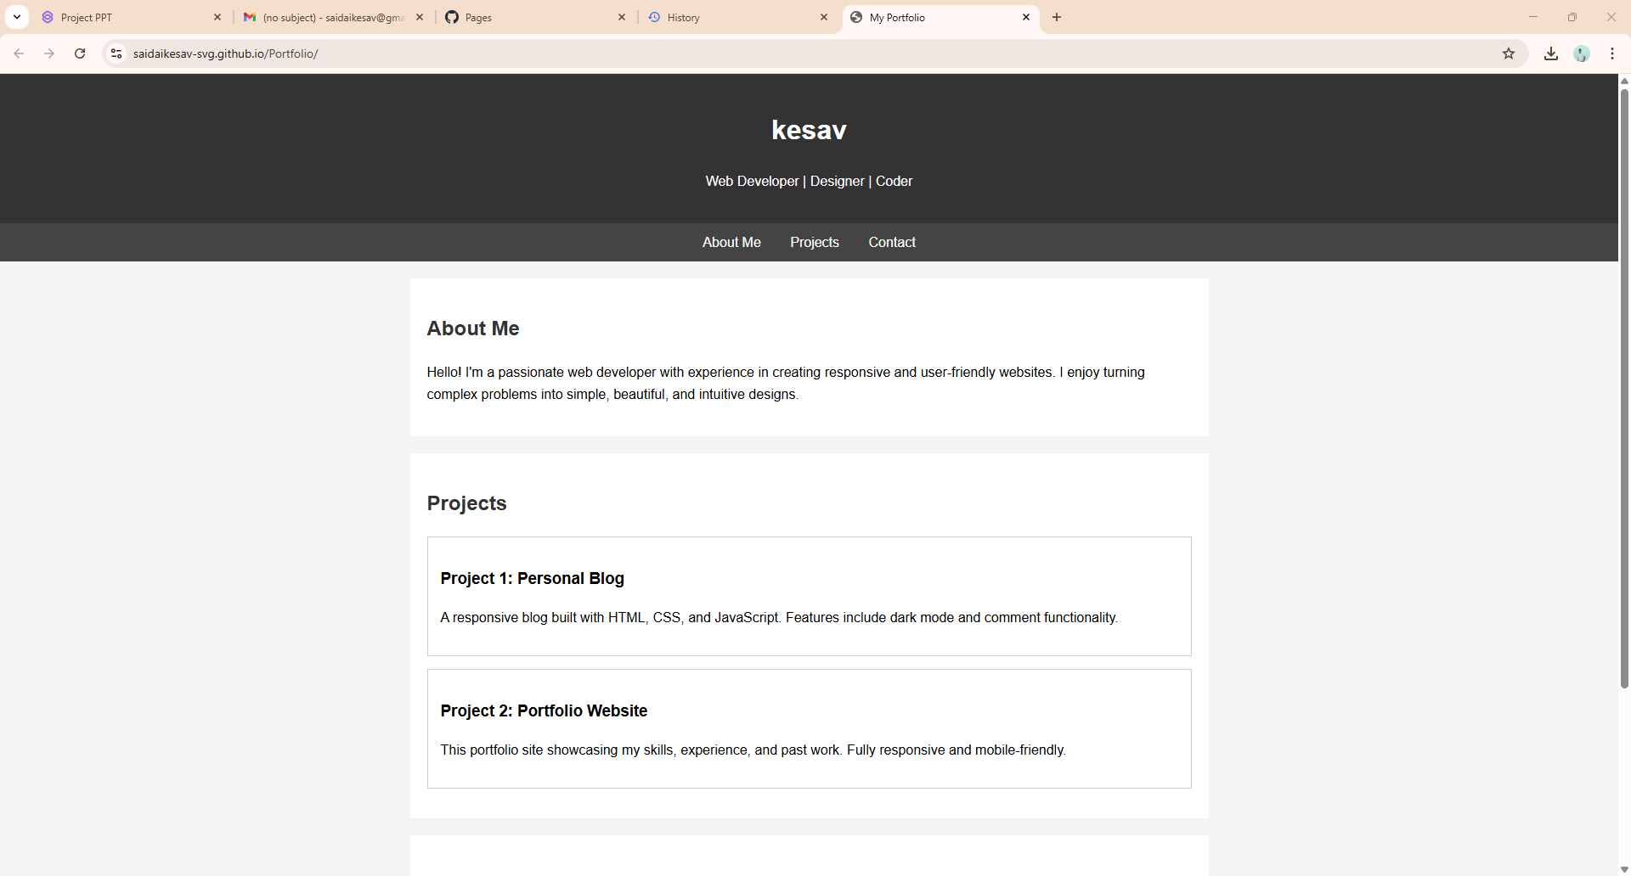

RESULTS AND SCREENSHOTS
PORTFIFO LINK: https://saidaikesav-svg.github.io/Portfolio/
3/21/2024 Annual Review
10

Slide 11
CONCLUSION
This personal portfolio project effectively showcases my skills, creativity, and professional experience in a visually engaging and user-friendly manner. With a clean layout, responsive design, and interactive features like smooth scrolling and a mobile-friendly menu, it serves as a powerful digital identity. By highlighting key strengths and a featured project, it not only builds personal branding but also opens doors to career opportunities, collaborations, and client engagements.
11

